Slide 1
ONLINE POLLING SYSTEM
Presented by
GHAVYA RAVICHANDRAN

Slide 2
TABLE OF CONTENTS
About cmot
Project requirements
Use cases
Technologies used
Application Flow
My contributions

Slide 3
REQUIREMENTS
To build an online polling system to enable various users to participate in polls and surveys for research purposes
Pages to add/modify/delete polls/questions/options
Capture the result of all the polls
Java service to integrate all functionalities
Data layer
Login management

Slide 4
CMOT
Global Reconciliation Unit
Volker Aggregator
Trade surveillance
DATA team
User Experience team

Slide 5
USE CASES
Strengthen customer relationships
Discover new product or services.
Gauge your marketing efforts
Analyze and track customer insights
Evaluate employee satisfaction
Get feedback on meeting, training, and events

Slide 6
ROLES
ROLES
ADMIN
POLLMASTER
USER
FUNCTIONALITIES:
Add category
Edit category
Add question
Edit question
Delete question
Delete category
Edit role of users
Assign poll masters
Activate/Deactivate polls
View all results
FUNCTIONALITIES:
Edit category
Add question
Edit question
Delete question
Attend polls like user
View results for attended and assigned polls
FUNCTIONALITIES:
Attend active polls
View Result for the polls he has taken

Slide 7
ADMIN
LOGIN
VIEW POLLS
VIEW RESULTS
LOGOUT
ADD POLLS
EDIT POLLS
DELETE POLLS
ENABLE/DISABLE POLLS
SET ROLES
ASSIGN POLLMASTERS

Slide 8
POLL MASTER
POLL MASTER
VIEW POLLS
EDIT POLLS
VIEW RESULTS
SIGN-UP/
LOGIN
LOGOUT
USER FUNCTIONALITIES

Slide 9
USER
SIGN-UP/
LOGIN
VIEW POLLS
TAKE POLL
NO
SUBMIT POLL
SAVE?
YES
VIEW RESULTS
LOGOUT

Slide 10
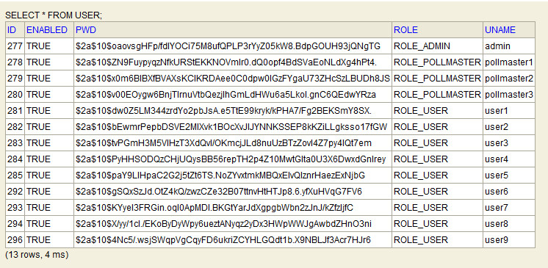
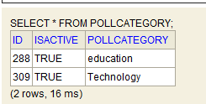
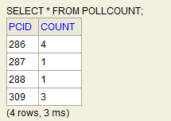
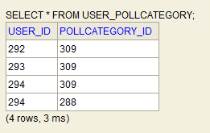
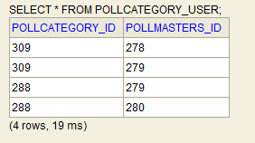
DATABASE VIEW
n
n
1
1
FOLLOWING ARE THE ASSOCIATED TABLES CREATED

Slide 11
TECHNOLOGIES USED
IDE | :Eclipse
Server | :Tomcat
Database | :H2
Testing | :Junit
Programming language | :Java
Framework (Backend) | :Spring MVC
Framework (Frontend) | :Bootstrap
Built Tool | :Maven

Slide 12
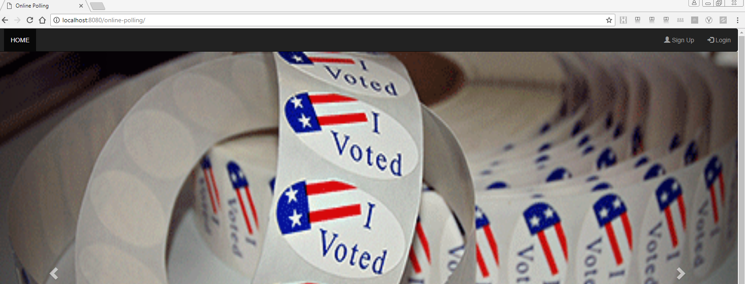
HOME PAGE

Slide 13
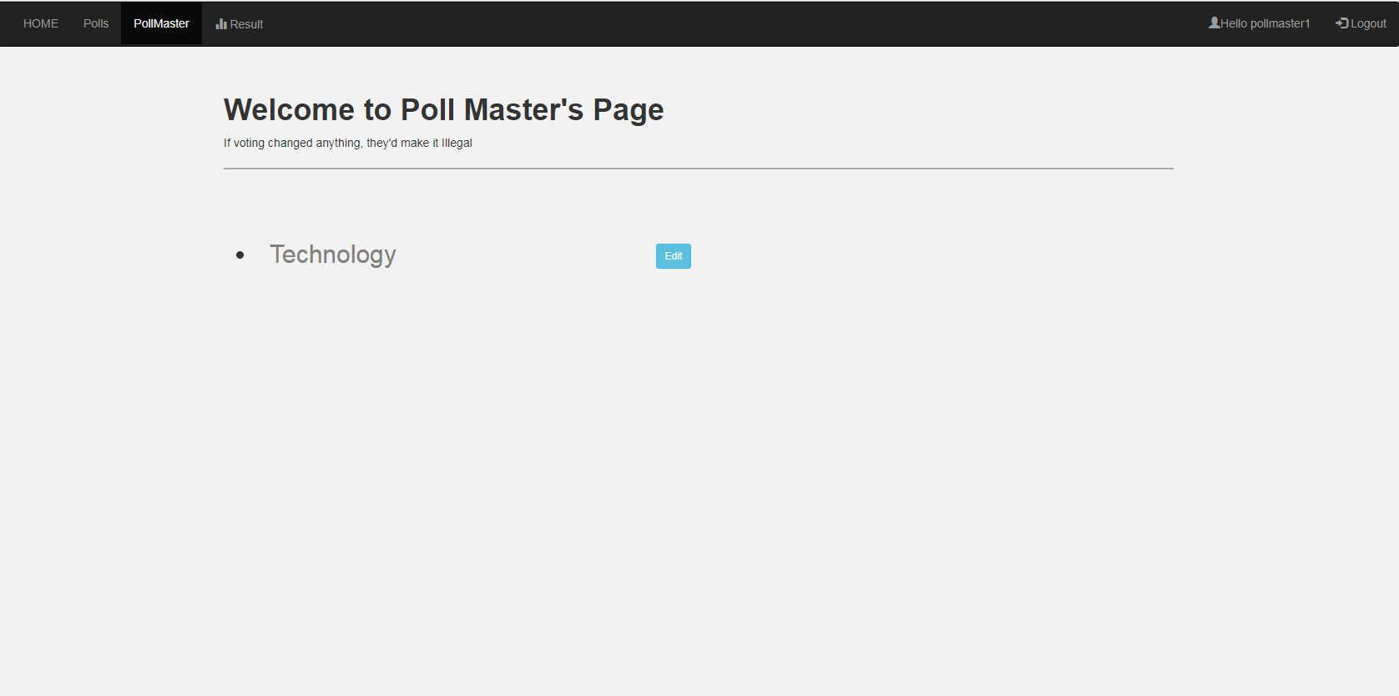
HOME PAGE (Contd..)
This is the home page for our Web Application
It contains the navigation bar to perform various functionalities
Once the user is authenticated as an authorized person depending upon the user’s role the navigation bar displays only his/her functionalities.
It also displays the user’s name in the top-right
CONCEPTS LEARNT
Bootstrap framework
CONCEPTS USED
Bootstrap navbar

Slide 14
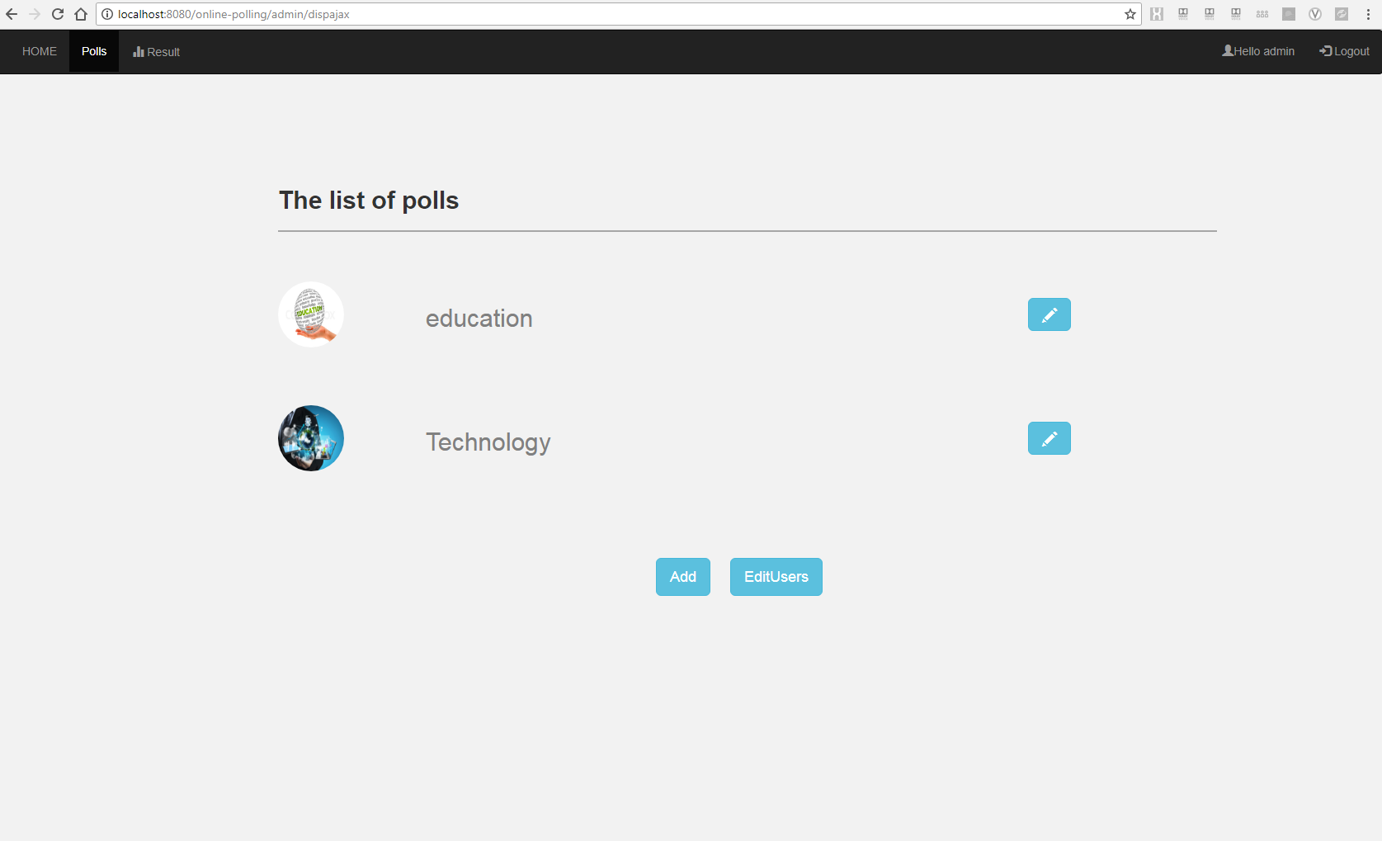
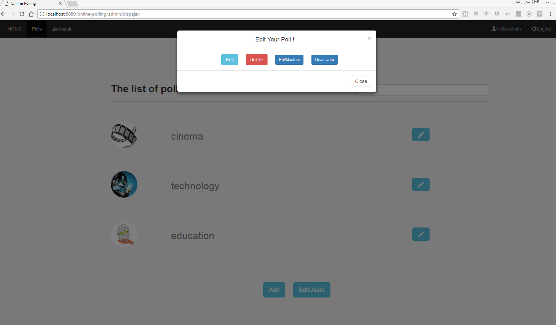

Slide 15
EDIT CATEGORY
ADD QUESTION
EDIT QUESTION
DELETE QUESTION

Slide 16
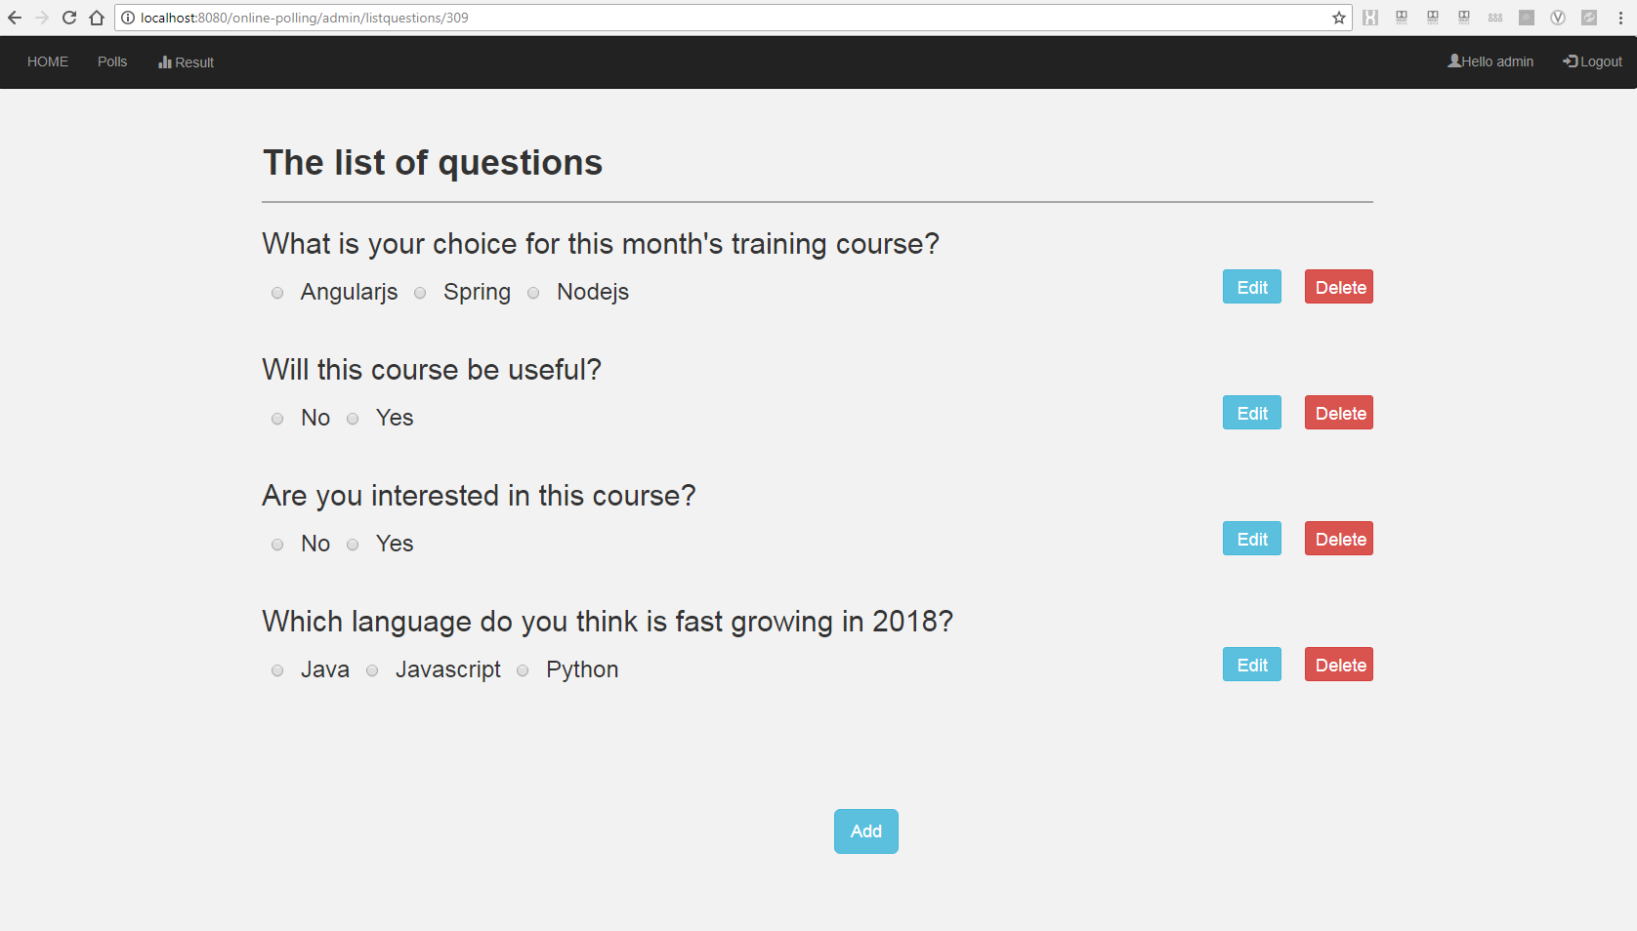
ADD QUESTION
The Question is inserted into the database
Here one can add or delete options dynamically
CONCEPTS LEARNT AND USED
Javascript
Hibernate validator
GSON
Map

Slide 17
EDITING THE QUESTION
While editing the question it will replace itself in the database
Here also one can add or delete options dynamically
Once the question is edited the it’s count will become zero in the result.
CONCEPTS LEARNT AND USED
Javascript
Hibernate validator
GSON
Map

Slide 18
DELETING THE QUESTION
Once the question is deleted it will be removed from the database
It will also be removed from the associated table
CONCEPTS LEARNT AND USED
GSON
Map

Slide 19
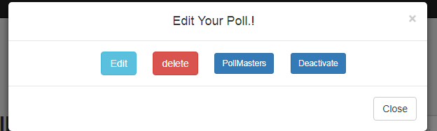
ACTIVATE/DEACTIVATE THE POLLS
Only the Admin can activate or deactivate the polls
The user and poll master will be able to view the polls only when they are activated

Slide 20
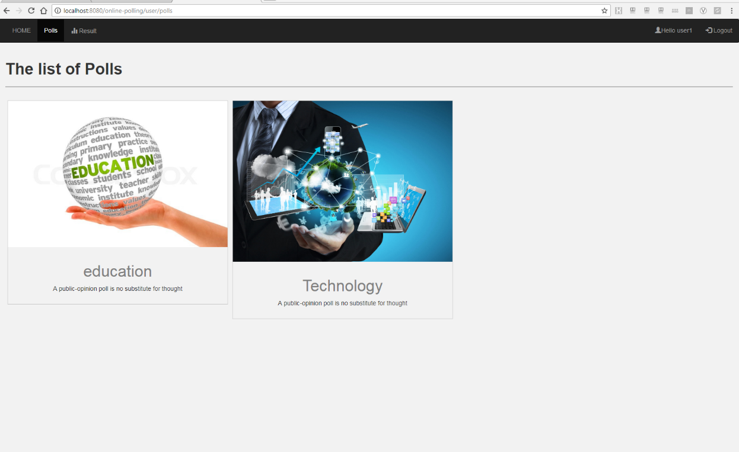
LISTING THE POLLS
POLLS TAB FOR VARIOUS ROLES | FUNCTIONALITIES
Admin | List all the polls
User | List active and unattended polls
CONCEPTS LEARNT
Querying the database
CONCEPTS USED
Hibernate queries

Slide 21
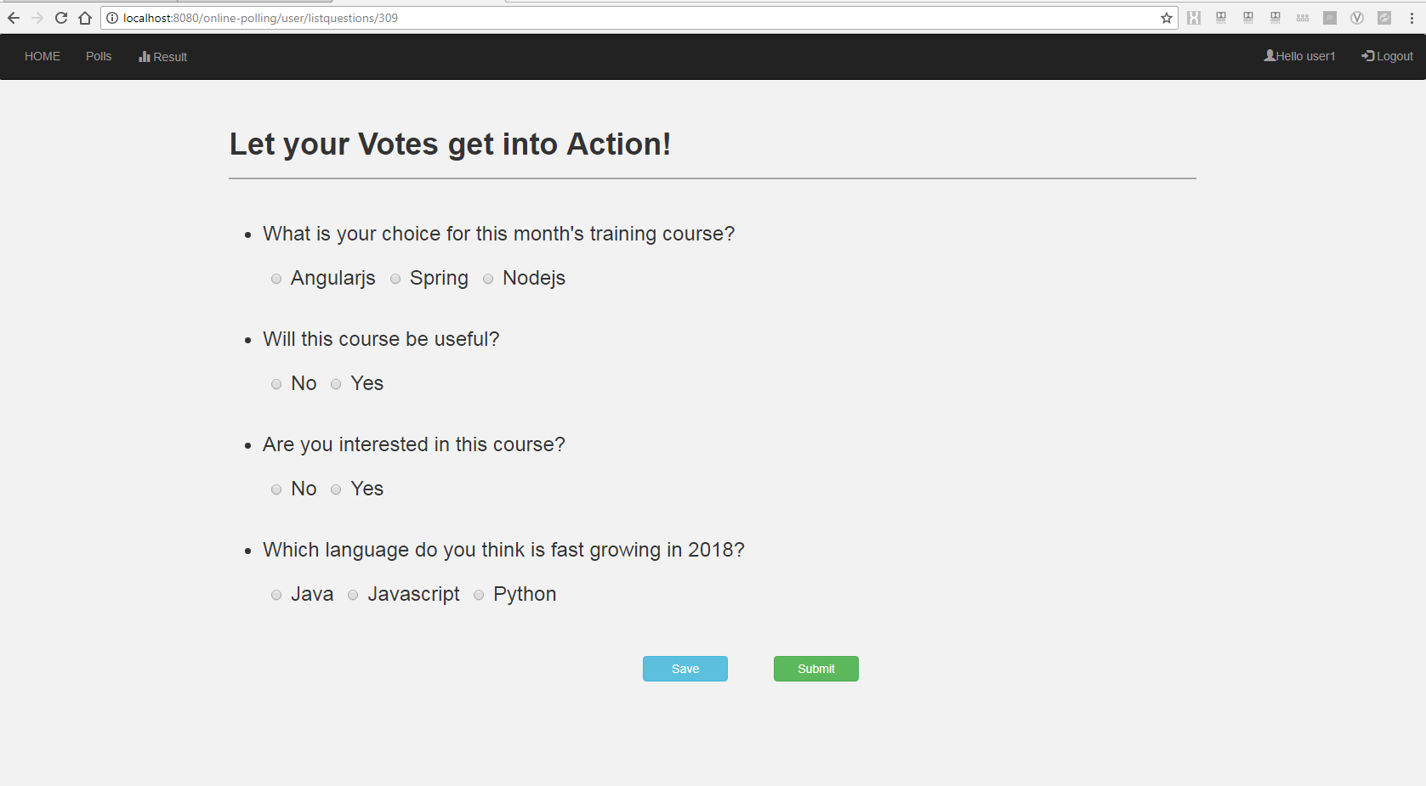
LISTING THE QUESTIONS UNDER EACH POLL
The list of polls under that Poll Category will be displayed
You can either save or submit the poll
CONCEPTS USED AND LEARNT
GSON
Map

Slide 22
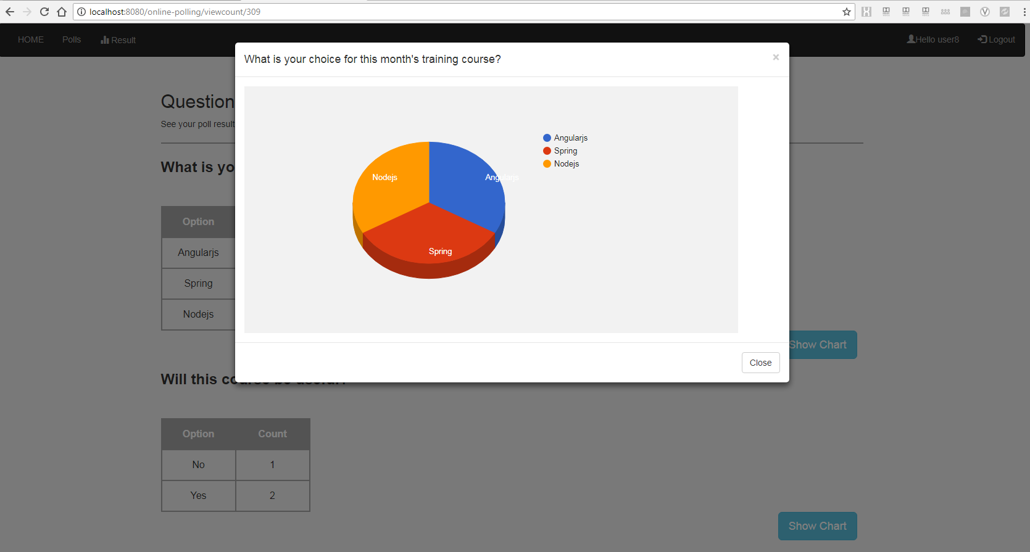
DISPLAYING THE RESULTS IN CHARTS
Once the user has submitted the polls he will be able to see the results of that poll
It will contain all the Questions results in a tabulated form along with the chart
It can also be viewed in the “Result” tab later
CONCEPTS LEARNT
Javascript
CONCEPTS USED
Google charts

Slide 23
ADDITIONAL FUNCTIONALITIES
Having images for each polls
Tooltip for few buttons
Disabling the back button
Displaying appropriate Alert messages

Slide 24


